Slide 1
IT Professional Environment: Law, Ethics and Privacy
Week 12:
Lecturer: Dr. Farshid Keivanian

Slide 2
Step-by-Step Guide for ICT406 Assessment 4: Business Proposal Report
Introduction: This guide will walk you through the process of completing your Assignment 4 for ICT406. The task involves rewriting the privacy and security policy for a law firm that has recently suffered a data breach. The goal is to ensure that the new policy is robust, respects ethical standards, and aligns with Australian data protection laws. Each section of the policy must reflect the topics covered in the lectures, including ethics, cybersecurity, and intellectual property rights. Below is a step-by-step breakdown to help you structure your assignment and engage with the material effectively.

Slide 3
Step-by-Step Guide for ICT406 Assessment 4: Business Proposal Report
Step 1: Cover Page and Table of Contents
Before diving into the content, make sure you set up your document correctly.
Cover Page: Include:
Subject Name and Number
Assignment Number (e.g., Assignment 4)
Your Full Name and Student ID
Table of Contents:
Use Microsoft Word's tool to automatically generate the Table of Contents.
Ensure it includes all the sections and correct page numbers.

Slide 4
Step-by-Step Guide for ICT406 Assessment 4: Business Proposal Report
Step 2: Introduction (4 Marks)
The Introduction is crucial for setting the stage. You need to provide a brief overview of the problem (the data breach) and state the goals and objectives of the new privacy and security policy.
Guidance:
Explain the current problem: A data breach has compromised client information.
Describe the goal: To create a privacy and security policy that aligns with ethical standards and ensures data protection.
State the objective: To protect client data and comply with Australian privacy laws.

Slide 5
Step-by-Step Guide for ICT406 Assessment 4: Business Proposal Report
Example: "The recent data breach at the law firm highlights the need for a comprehensive privacy and security policy. The aim of this policy is to ensure the protection of sensitive client information, align with legal and ethical standards, and provide a framework for cybersecurity measures."

Slide 6
Step-by-Step Guide for ICT406 Assessment 4: Business Proposal Report
Step 3: Privacy and Security Policy (20 Marks)
This is the main section of the assignment where you will rewrite the law firm's privacy and security policy. Below is a breakdown of how to approach each part:
Introduction: Provide a brief explanation of the importance of data privacy and security.
Information they collect: Identify the types of information the law firm collects (e.g., personal data, financial data).
How they collect the information: Explain the methods used for data collection (e.g., client forms, legal documents).
How they use this personal information: Outline how the firm uses the data (e.g., for legal advice, case management).

Slide 7
5. How they disclose this personal information: Describe how and under what circumstances the firm discloses client information (e.g., to legal authorities or third parties).
6. Use of cookies and tags by the firm: Address whether the firm uses cookies for their website and explain their purpose (e.g., improving user experience).
7. How they keep and secure information in respect to cybersecurity: Discuss cybersecurity measures such as encryption, firewalls, and secure data storage.
8. Would they disclose (and how) any information across borders: Explain if the firm shares information across borders and how they comply with international data protection laws.

Slide 8
Step-by-Step Guide for ICT406 Assessment 4: Business Proposal Report
9. Managing complaints about breach of confidentiality: Describe the process for managing client complaints related to data breaches.
10. How they protect Australian data protection laws: Ensure the policy aligns with laws like the Australian Privacy Principles (APPs).
11. Changes and revision plan for next policy: Outline how and when the firm will review and update the privacy policy.
12. How the clients can contact: Provide contact information for clients to reach out with concerns or questions.

Slide 9
Step-by-Step Guide for ICT406 Assessment 4: Business Proposal Report
Step 4: Relevance to Lecture Materials (10 Marks)
Link your privacy and security policy to key topics discussed in class, such as ethics, privacy breaches, surveillance, and intellectual property. Here’s how to connect each section of the policy to lecture materials:
Ethics in Information Technologies: Show how the policy ensures ethical treatment of client data.
Surveillance Issues: Discuss how the firm uses CCTV or other monitoring tools without infringing on privacy rights.

Slide 10
Step-by-Step Guide for ICT406 Assessment 4: Business Proposal Report
Breach of Individual Rights: Ensure the policy protects clients' individual rights, especially regarding their sensitive data.
Cybersecurity Measures: Mention specific cybersecurity techniques to prevent future data breaches.
Intellectual Property: Address how the firm protects IP-related documents.

Slide 11
Step-by-Step Guide for ICT406 Assessment 4: Business Proposal Report
Step 5: Conclusion (2 Marks)
In the Conclusion, summarize the key elements of the policy and any challenges encountered during the process.
Guidance:
Recap the importance of the new policy.
Highlight any assumptions made during the policy creation.
Mention any future considerations, such as evolving data protection laws or changes in technology.

Slide 12
Step-by-Step Guide for ICT406 Assessment 4: Business Proposal Report
Example: "This privacy and security policy provides a robust framework to protect client data while respecting legal and ethical standards. The implementation of cybersecurity measures and compliance with Australian Privacy Principles are critical to preventing future breaches."

Slide 13
Step-by-Step Guide for ICT406 Assessment 4: Business Proposal Report
Step 6: References (2 Marks)
Use APA style referencing for all sources, including textbooks, class materials, and any online resources.
Ensure that you cite all your sources to avoid plagiarism and ensure credibility.
Guidance:
Include in-text citations throughout your policy where necessary.
List all sources at the end of the document in APA format.

Slide 14
Step-by-Step Guide for ICT406 Assessment 4: Business Proposal Report
Step 7: Example Walkthrough (Similar Scenario)
Let’s work through a similar example to guide you:
Scenario Example: A large healthcare provider in Melbourne recently experienced a data breach, exposing sensitive patient information. As part of their IT governance team, you’ve been tasked to rewrite the privacy and security policy to prevent future breaches. You will focus on aligning the policy with the Healthcare Privacy Act and ensuring compliance with ethical data handling practices.
You would follow the same steps, adjusting the details to reflect the healthcare context instead of the law firm.

Slide 15
Group Class Activity: Presentation on IT Governance and Privacy
Objective:
Students will explore key issues related to IT governance, privacy, and cybersecurity by selecting a topic and preparing a group presentation. Each group will present their findings, propose solutions, and engage in a class discussion.

Slide 16
Group Class Activity: Presentation on IT Governance and Privacy
Topics to Choose From:
Privacy Policy Drafting for Specific Industries:
Choose one industry (Healthcare, Finance, or Education) and draft a privacy and security policy.
Requirements:
Highlight the unique privacy and security concerns for the chosen industry.
Align the policy with relevant laws (e.g., Australian Privacy Principles, Healthcare Privacy Act).
Include sections like data collection, storage, cybersecurity measures, and breach response.
Presentation: Discuss how the nature of the industry impacts privacy requirements and the approach to security.

Slide 17
Group Class Activity: Presentation on IT Governance and Privacy
2. Cybersecurity Threat Analysis and Mitigation:
Analyze three types of cybersecurity threats (Ransomware, Phishing, Insider Threats).
Requirements:
Explain the nature of each threat and provide real-world examples.
Propose IT governance strategies and security policies to mitigate these threats.
Discuss how companies can balance security measures with privacy protection.
Presentation: Describe mitigation techniques and their effectiveness in preventing data breaches.

Slide 18
Group Class Activity: Presentation on IT Governance and Privacy
3. Ethical Issues in IT:
Explore the ethical challenges surrounding privacy, surveillance, and data breaches in the IT environment.
Requirements:
Discuss ethical implications of surveillance tools (e.g., CCTV, data monitoring) used in organizations.
Highlight case studies where privacy was compromised due to inadequate ethical considerations.
Provide solutions that balance privacy rights with the need for security.
Presentation: Present ethical dilemmas and how companies can implement policies to address them.

Slide 19
Group Class Activity: Presentation on IT Governance and Privacy
Instructions:
Each group will choose one of the topics above.
Prepare a 10-15 minute presentation that includes:
An introduction to the topic.
Real-world examples or case studies.
Proposed solutions or policies.
A class discussion question to engage peers.
Bonus: Groups that incorporate recent news events or company case studies (e.g., data breaches in Australian companies) will receive extra points.

Slide 20
Group Class Activity: Presentation on IT Governance and Privacy
This activity encourages students to engage with the material on privacy, ethics, and cybersecurity, while developing critical thinking and presentation skills.

Slide 21
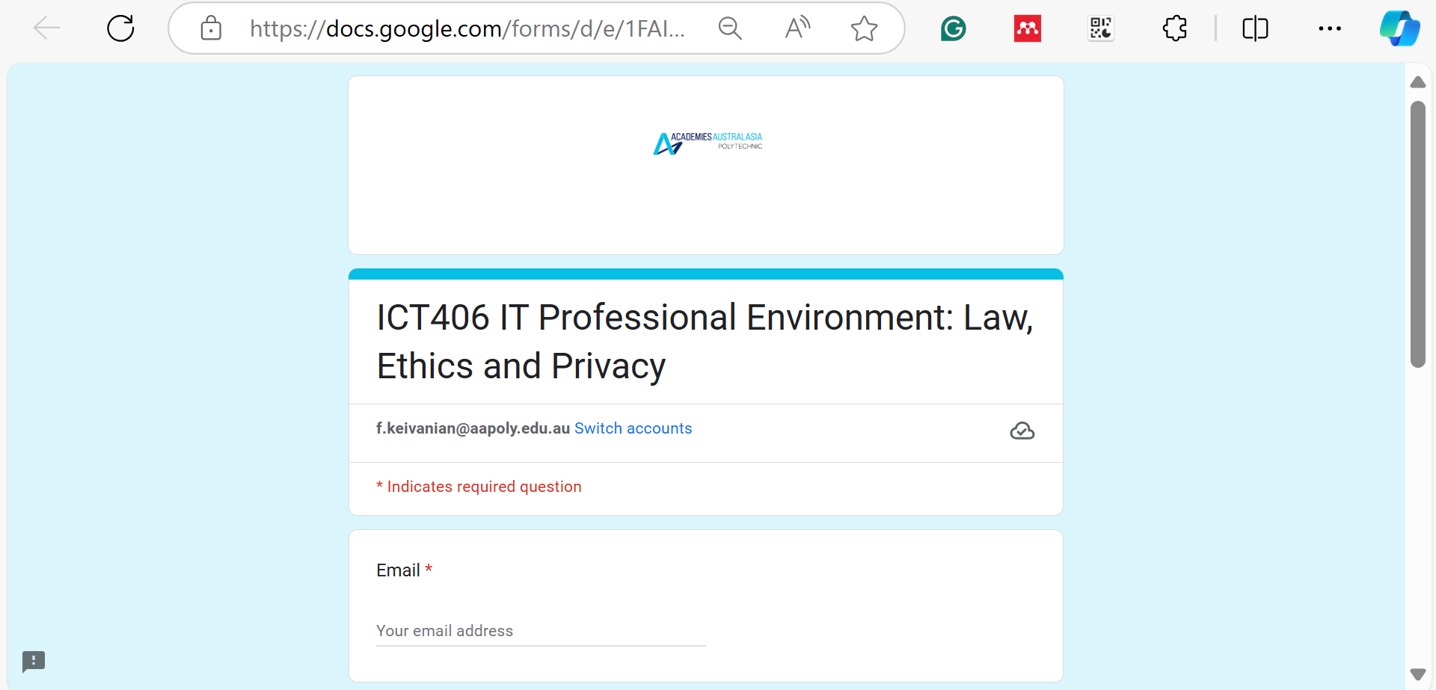
ICT406 IT Professional Environment: Law, Ethics and Privacy (google.com)

Slide 22

Happy A Learning Day!
Thank You!
Dr. Farshid Keivanian

